Slide 1
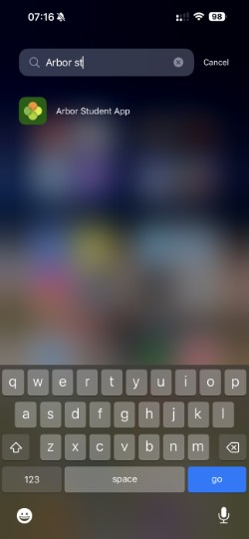
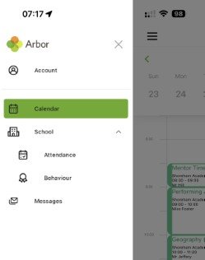
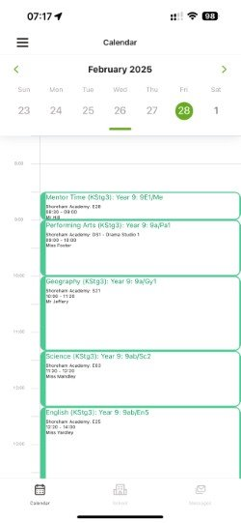
The ARBOR App Reset your password
Use your email link to change this and then log in
Check your timetable!

Slide 2
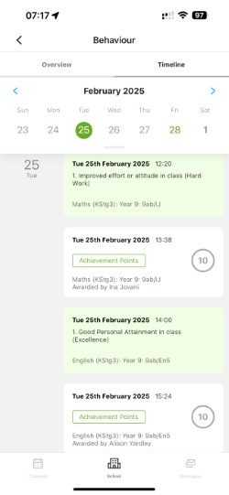
Check your Attendance!
Goodluck
Let's see how many you can get!

